Slide 1
Cost of living crisis - structural racism and minoritised women
Gargi Bhattacharyya

Slide 2
How do we think about inequality?
Implication that there is an acceptable norm and subordinated groups fall below the norm
But hardship is very widespread - with contestation about what an acceptable norm might be
Focusing on the disparities between quite poor and very poor people might not be the most useful way to think about this crisis

Slide 3
A differentiated but shared crisis
Instead can we look at the experience of structural racism as a way of understanding how economic crisis exacerbates tension points for poor communities?

Slide 4
Normalisation of poverty demands some adjustment in our analytic approach
Most racially minoritised groups are more likely to be poor - and to face other challenges around housing, employment and access to services
But what we are describing in terms of the impact of the cost of living crisis is not comprehensible as arising from the culture or position or even the particularity of any ethnic group

Slide 5
Women and children and racialised poverty
We know:
Low levels of paid employment for some groups
High levels of child poverty
High levels of disability and chronic illness
And although there have been rapid increases in proportions of Bangladeshi and Pakistani women engaged in paid work, in-work poverty remains very high

Slide 6
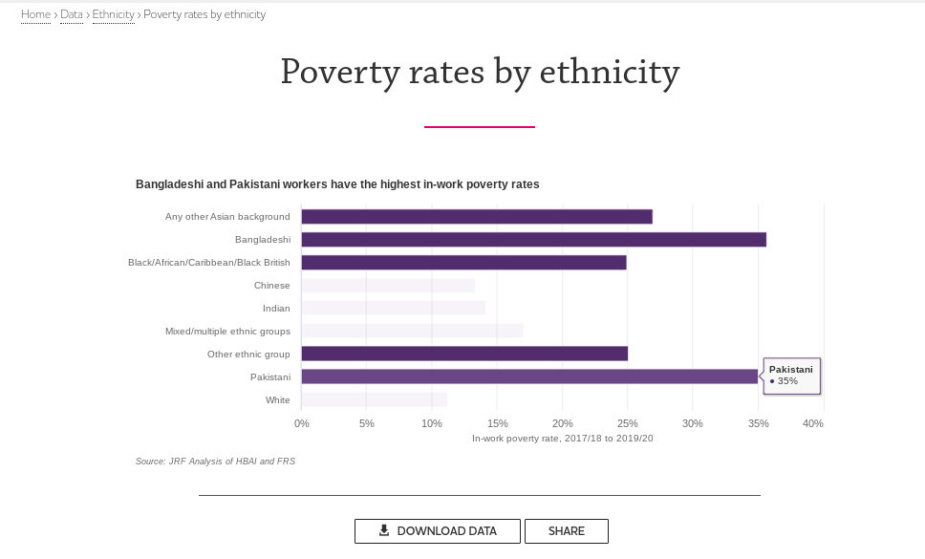

Slide 7
Racialised poverty as indicator of crisis points
Racially minoritised groups do not live separate lives
The crisis points in the experience of racially minoritised groups illuminate systemic blockage points
Instead of thinking about why group X has such high levels of housing poverty, maybe let us think about how the cumulative barriers faced by group X lead to this outcome?

Slide 8
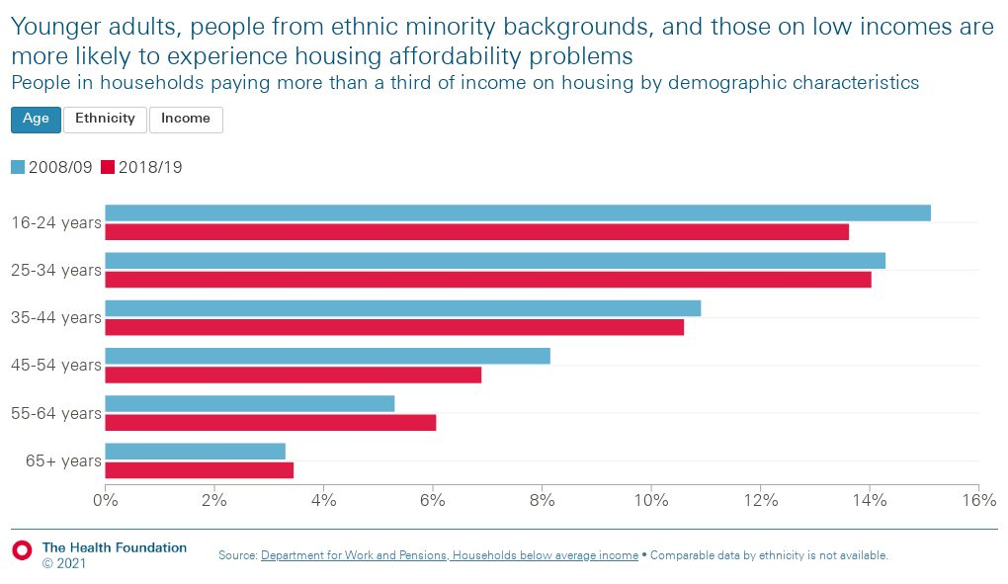

Slide 9
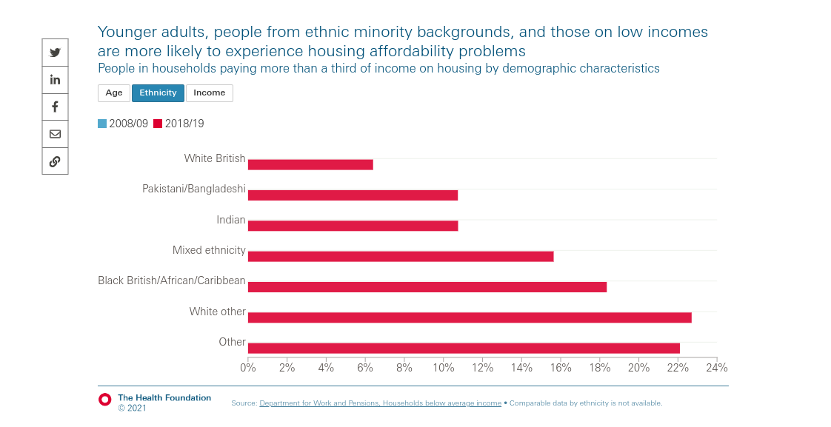

Slide 10
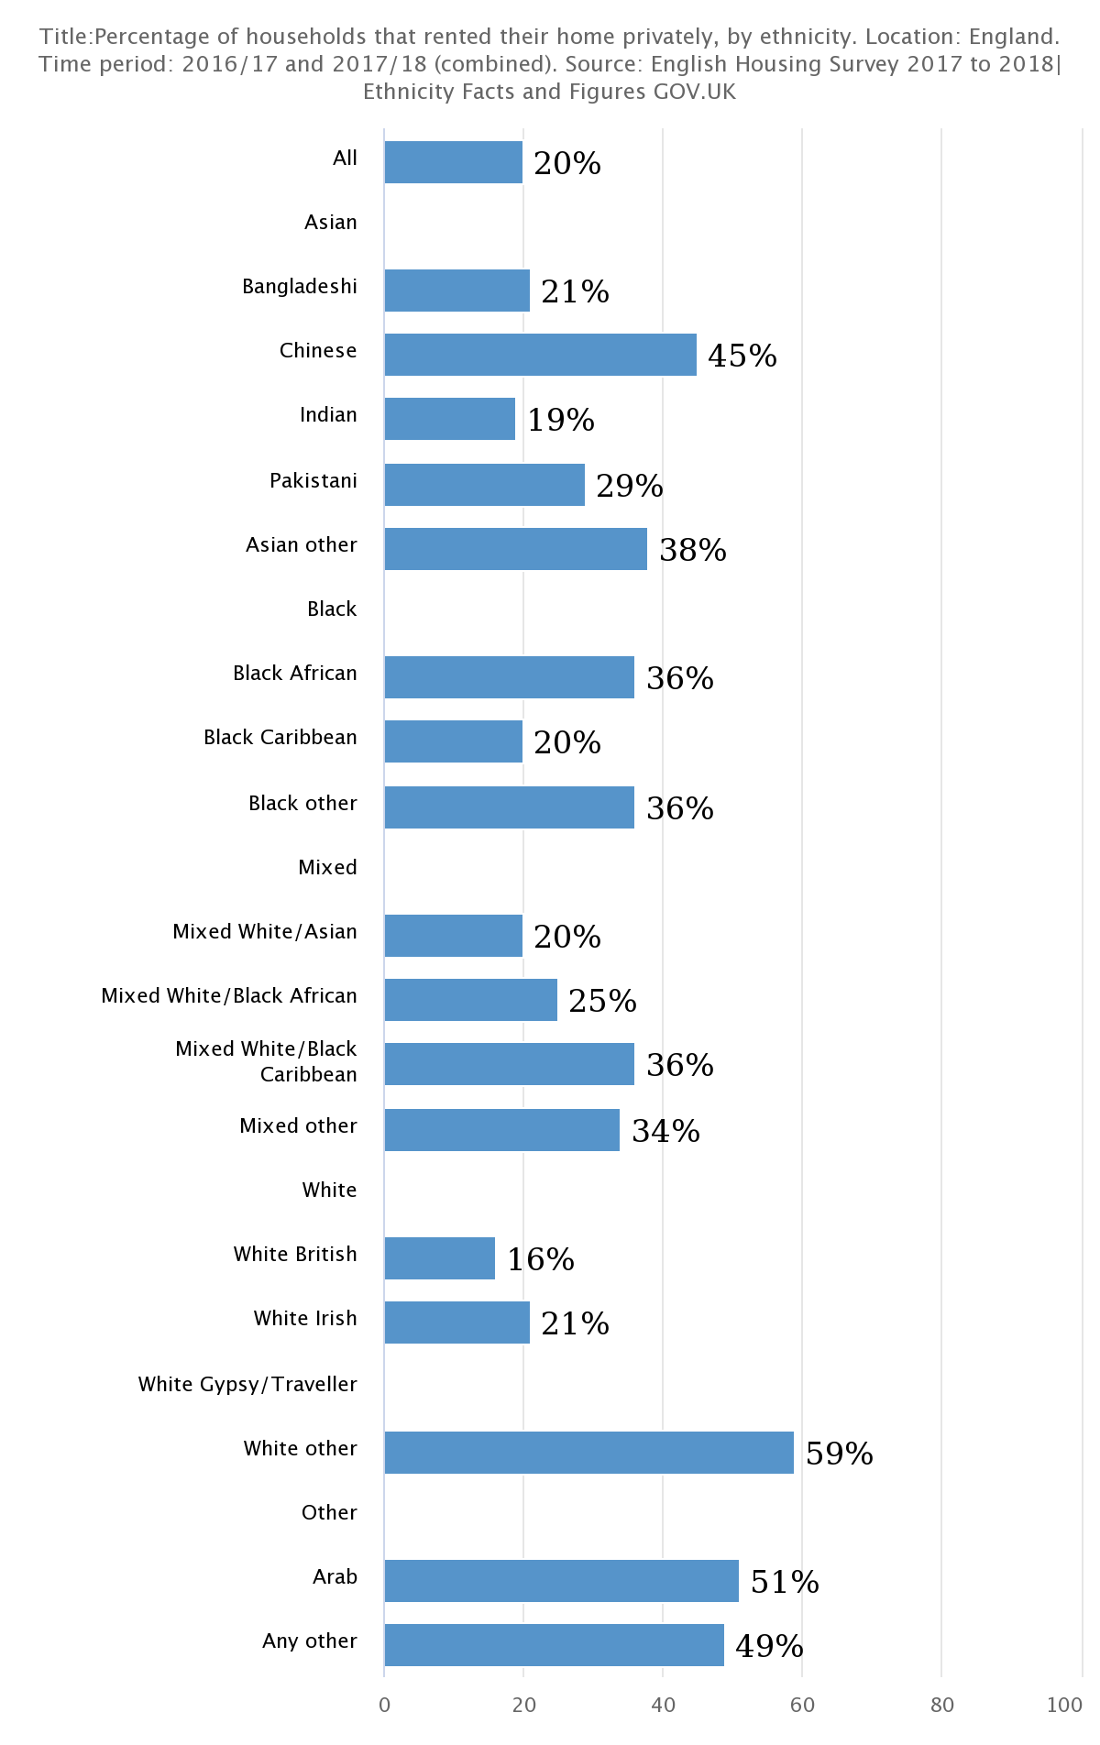
Who rents?
Rent is an identifiable pressure point - looking at who rents and who is forced to move can help us grasp the manner in which this crisis is hitting

Slide 11
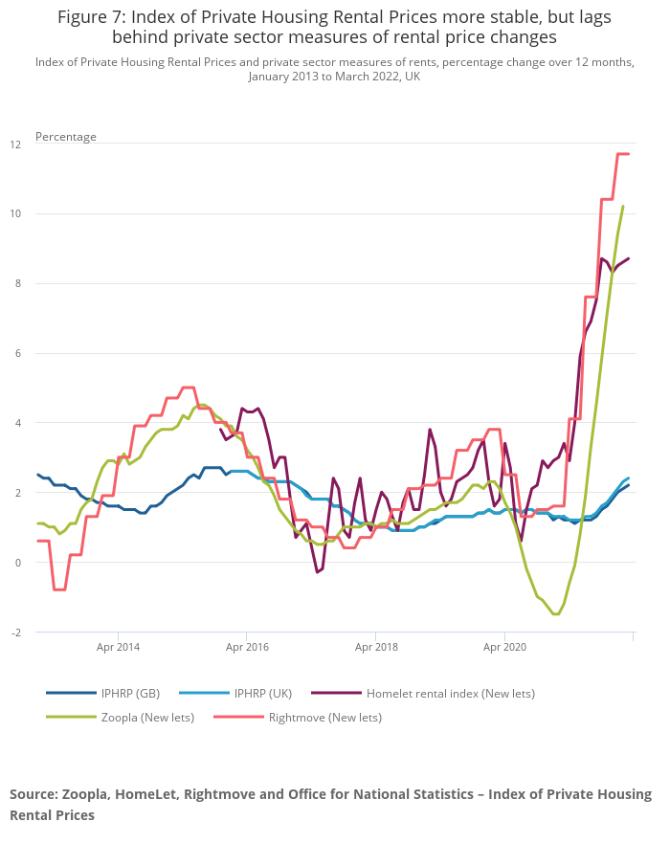
It also matters who you ask
Although IPHRP shows a modest but consistent rise, Zoopla and Rightmove indicate something different

Slide 12
Very likely that racially minoritised women will face additional challenges during this phase of economic crisis
However, they will not be alone in this

Slide 13
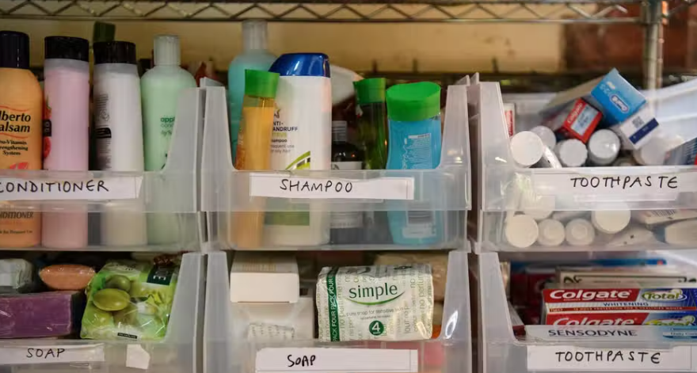
Beyond disproportionality
In every space where additional hardship arises other life histories will be represented:
-disability and chronic illness,
- histories of state violence and/or neglect,
- the widespread impoverishment of the new normal where an analysis of disproportionality is a poor tool to challenge injustice

Slide 14
How to understand poverty by thinking about ‘race’
The landscape of racialised inequality throws into relief the cumulative processes of dispossession and disadvantage that make some people so much more likely to suffer extreme material hardship
Think of ‘race’ as a process - a journey through official institutions and opportunities and assembled social goods - with the arbitrary marker of ‘race’ shaping how well or badly each encounter goes

Slide 15
How to uncover the machinery of impoverishment
‘Race’ also lets us know what resources a person might be carrying, or be able to access - and how under or unprotected they might be in the public square
The analytic tools arising from charting the cumulative processes that make some more likely to be poor - systemic, violent, exclusionary - open the possibility of re-articulating how we survive and thrive together.

