Slide 1
Trade and Health: A gender analysis
A briefing for the Women’s Budget Group by
Dr Silke Trommer
University of Manchester
silke.trommer@manchester.ac.uk

Slide 2
Overview
Trade and health: a feminist issue
Standard commitments in trade agreements and the trade & health nexus
UK trade policy initiatives
Goods liberalisation in UK FTAs and food environments
Services liberalisation in UK FTAs and the NHS
Policy recommendations

Slide 3
Trade and health: A feminist issue
Trade and health nexus
Flows of products, services, investment, and technology
International legal obligations in trade agreements
Mostly studied within Public Health (McNamara et al. 2021) and International Law (Charnovitz 2000)
Social Reproduction (Elson 2012, Bakker 2007)
Life- and health-making work
Typically unpaid or underpaid
Social norms typically ascribe it to women
When carried out domestically, not considered part of “the economy”

Slide 4
Trade and health: A feminist issue
Care economy (provided across health systems and domestic and household based care settings)
Food economy (provisioned via the productive economy and the sphere of social reproduction)

Slide 5
Standard commitments in trade agreements and the trade & health nexus

Slide 6
UK trade policy initiatives
UK-Japan FTA, signed 23/10/20, entered into force 1/1/21
UK-Australia FTA, signed 16/12/21, undergoing ratification
UK-New Zealand FTA, signed 28/02/22, undergoing ratification
Currently under negotiation:
UK-US; UK-Canada; UK-India; UK-Mercosur; UK-Gulf States
CP-TPP accession

Slide 7
Goods liberalisation in UK FTAs and food environments
Complex relationship between goods liberalisation and food environments regarding the availability, the affordability, and the nutritional value of food and the shape and nature of food markets.
Women are predominantly responsible for household provisioning in food, and are disproportionately represented among households with limited spending power.
Question to ask: how do FTAs structure food markets, and what types of foods become available and affordable?

Slide 8
Goods liberalisation in UK FTAs and food environments
Agricultural products liberalised in UK-Japan/-Australia/-New Zealand
Pork, beef, sheep, grain, rice, dairy, sugar cane, alcoholic beverages, certain processed foods, fresh apples
Chapter 19 UK-Japan:
Promote trade in agriculture, exchanging information on sustainable agriculture, cooperating on technology, and improving the business environment for food and agricultural producers

Slide 9
Services liberalisation in UK FTAs and the NHS
Service liberalisation by service sector and mode of delivery
Positive list (GATS) v negative list approach
Liberalisation commitments do not preclude the service from being delivered as a public service, but introduce competition.
General exceptions to liberalisation commitments exist.
Women are prime users of public services, disproportionately employed in the health system, and provide domestic care when health systems are at limits.
Question to ask: how do service liberalisation commitments taken in an FTA affect the day-to-day running of the NHS/social care and domestic care settings?

Slide 10
Services liberalisation in UK FTAs and the NHS
Service liberalisation in UK-Japan/-Australia/-New Zealand
Negative list approach, including central, regional and local government and non-governmental bodies
Exclusions: professional services, research & development, business services, communication services, transport services, energy, agriculture, legal services; UK-New Zealand excludes health-related professional services and retail of pharmaceuticals and health and social services – to maintain professional qualification requirements and domestic regulations in the sectors
Ratchet clauses and Third Party MFN clauses included
General exceptions
Least trade restrictive measure and “necessary for” not “related to”

Slide 11
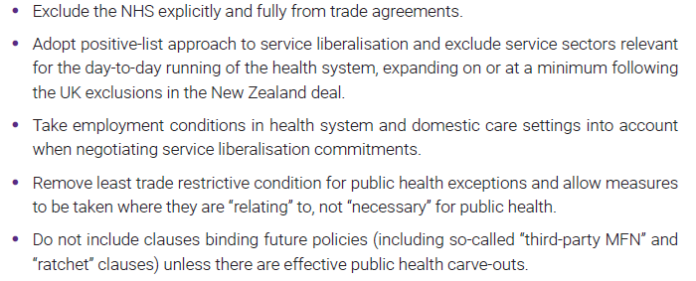
Policy recommendations

