Slide 1
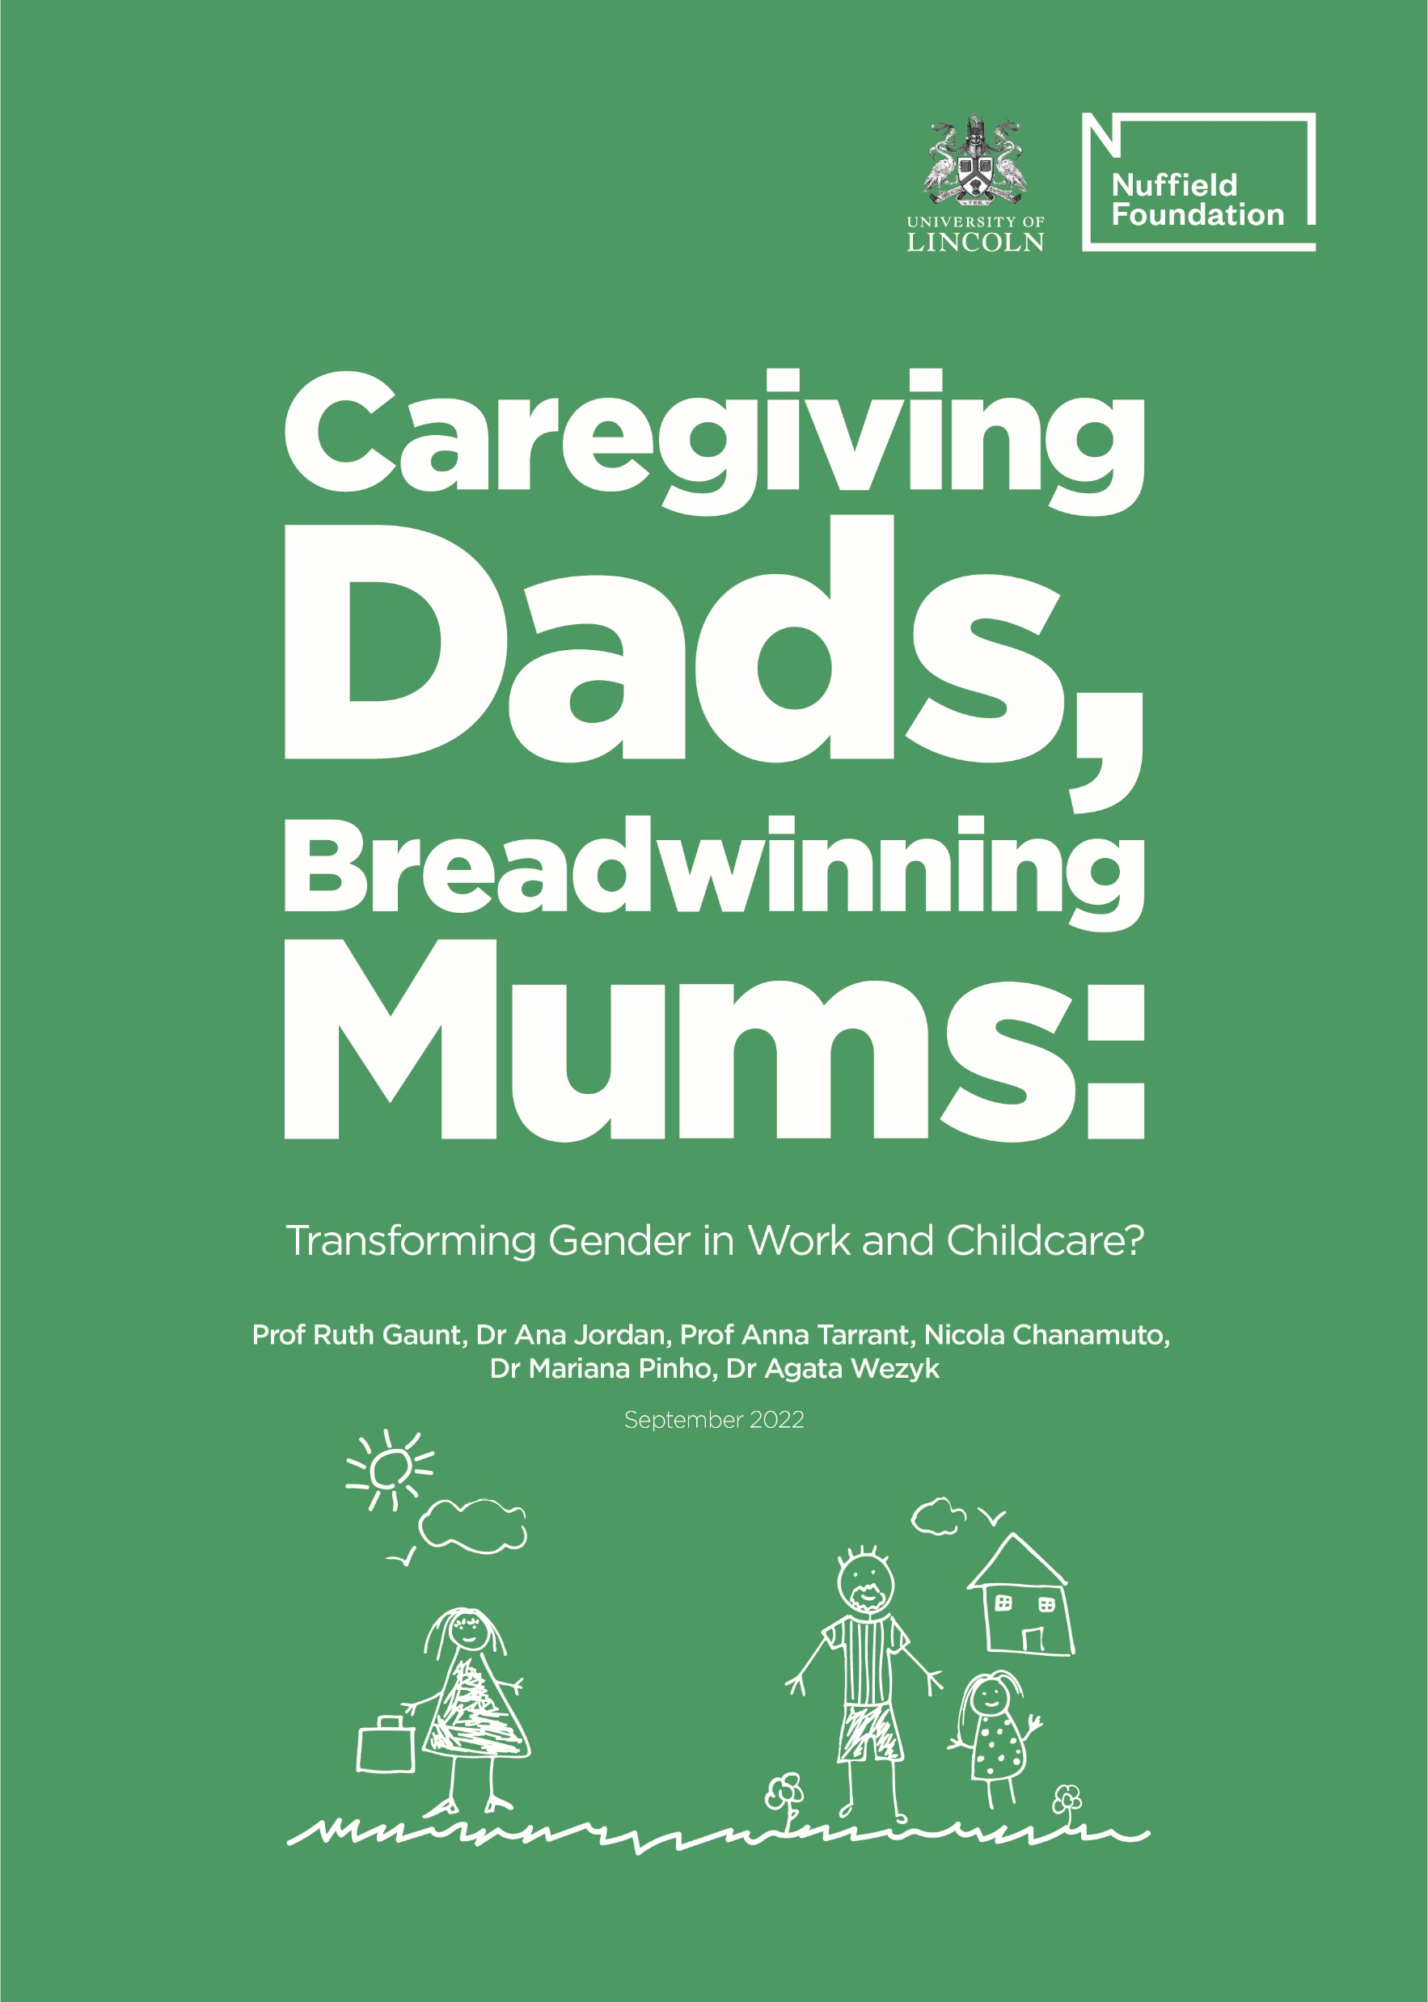
Caregiving Dads, Breadwinning Mums: Transforming gender in work and childcare? Prof Ruth Gaunt, Dr Ana Jordan, Prof Anna Tarrant, Nicola Chanamuto, Dr Mariana Pinho, Dr Agata Wezyk #sharingparenting
Report launch webinar 13th September 2022, 12.30-14.00

Slide 2
Why transforming gender in work and childcare?
Men’s and women’s involvement in paid work and childcare has become increasingly similar over the past decades.
However, work and care arrangements of most British couples continue to reflect traditional gendered norms, mothers as primary caregivers, fathers as main breadwinners.
This gender inequality in the home both disadvantages women in the workplace and denies men the opportunity to develop close nurturing relationships with their children.

Slide 3
How can a less gendered allocation of family roles be achieved?
First study to use mixed-methods to examine couples’ work and care arrangements from the perspectives of both mothers and fathers.
Uniquely compares equal sharers, role-reversed and traditional couples in a single comprehensive design.

Slide 4
Research design
1) The survey:
Analysis drew on extensive survey data from a nationally representative sample of 5,605 parents with children aged 11 or younger.
Data were collected in February 2020.
2) In-depth interviews:
In-depth, semi-structured interviews with 60 parents (30 couples) in each of the three study groups (equal-sharers, role-reversed, traditional).
Interviews were conducted between November 2020 and July 2021.

Slide 5
Key findings
Parents want to spend time with their children and be closely involved in their lives.
Couples feel forced to identify a main carer and a main breadwinner.
Opportunities for equal sharing are constrained by gendered parenting leave entitlements, long work hours cultures, limited options for flexible and part-time work, and expensive inaccessible childcare.
Couples who overcome these obstacles are characterised by a strong commitment to gender equality, mothers’ strong work identities and earnings, and fathers’ desire to be heavily involved in raising their children.

Slide 6
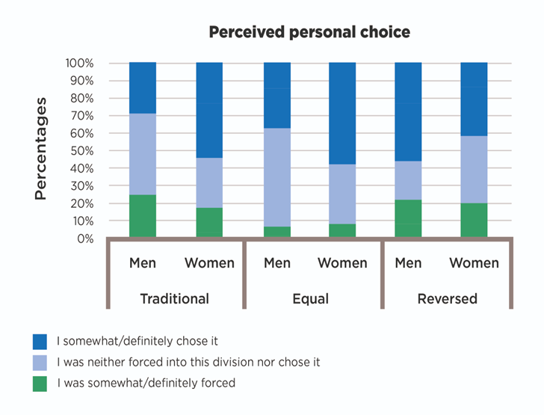
Key findings – traditional arrangements
25% of fathers in traditional arrangements felt forced into their roles.
Mothers in traditional arrangements reported significantly lower wellbeing and relationship quality than mothers who shared childcare equally or reversed roles:
‘I tend not to try…try and find solutions…anymore because I don’t think there is any [laughs], anything anymore I can do.’ (Karen, Traditional mother)

Slide 7
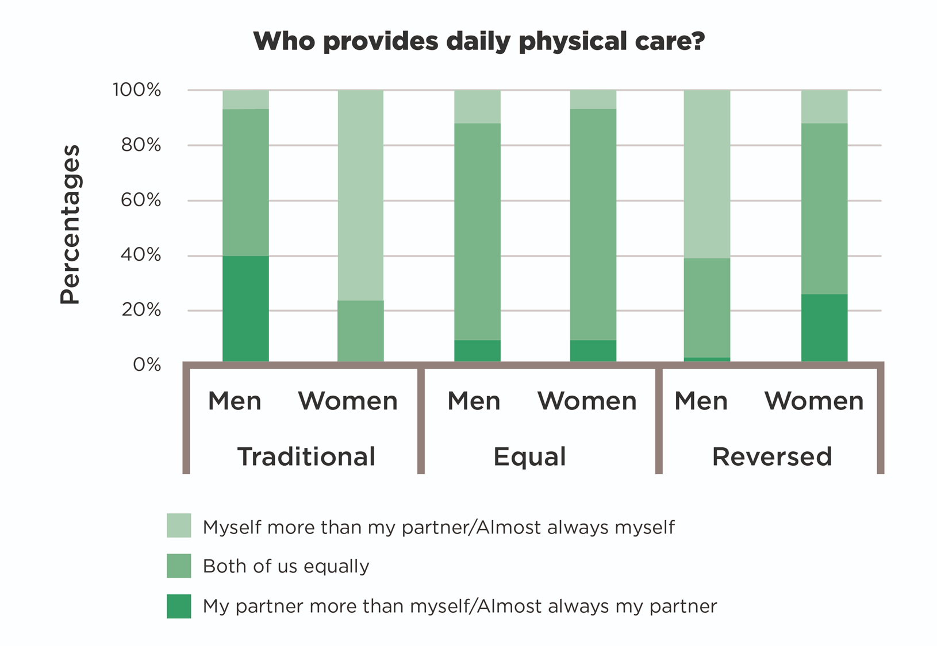
Key findings – reversing roles
Motivations to reverse roles:
‘I told my work that I would like to work two less days so I could look after the kid more because I didn’t see any point of having a child if you’re not gonna see the child or look after it or anything.’ (Jason, Role-reversed father, our emphasis)
Division of responsibilities mirrored traditional couples.
Tended to have slightly more equal division of childcare, with greater involvement by breadwinning mothers compared to breadwinning fathers.

Slide 8
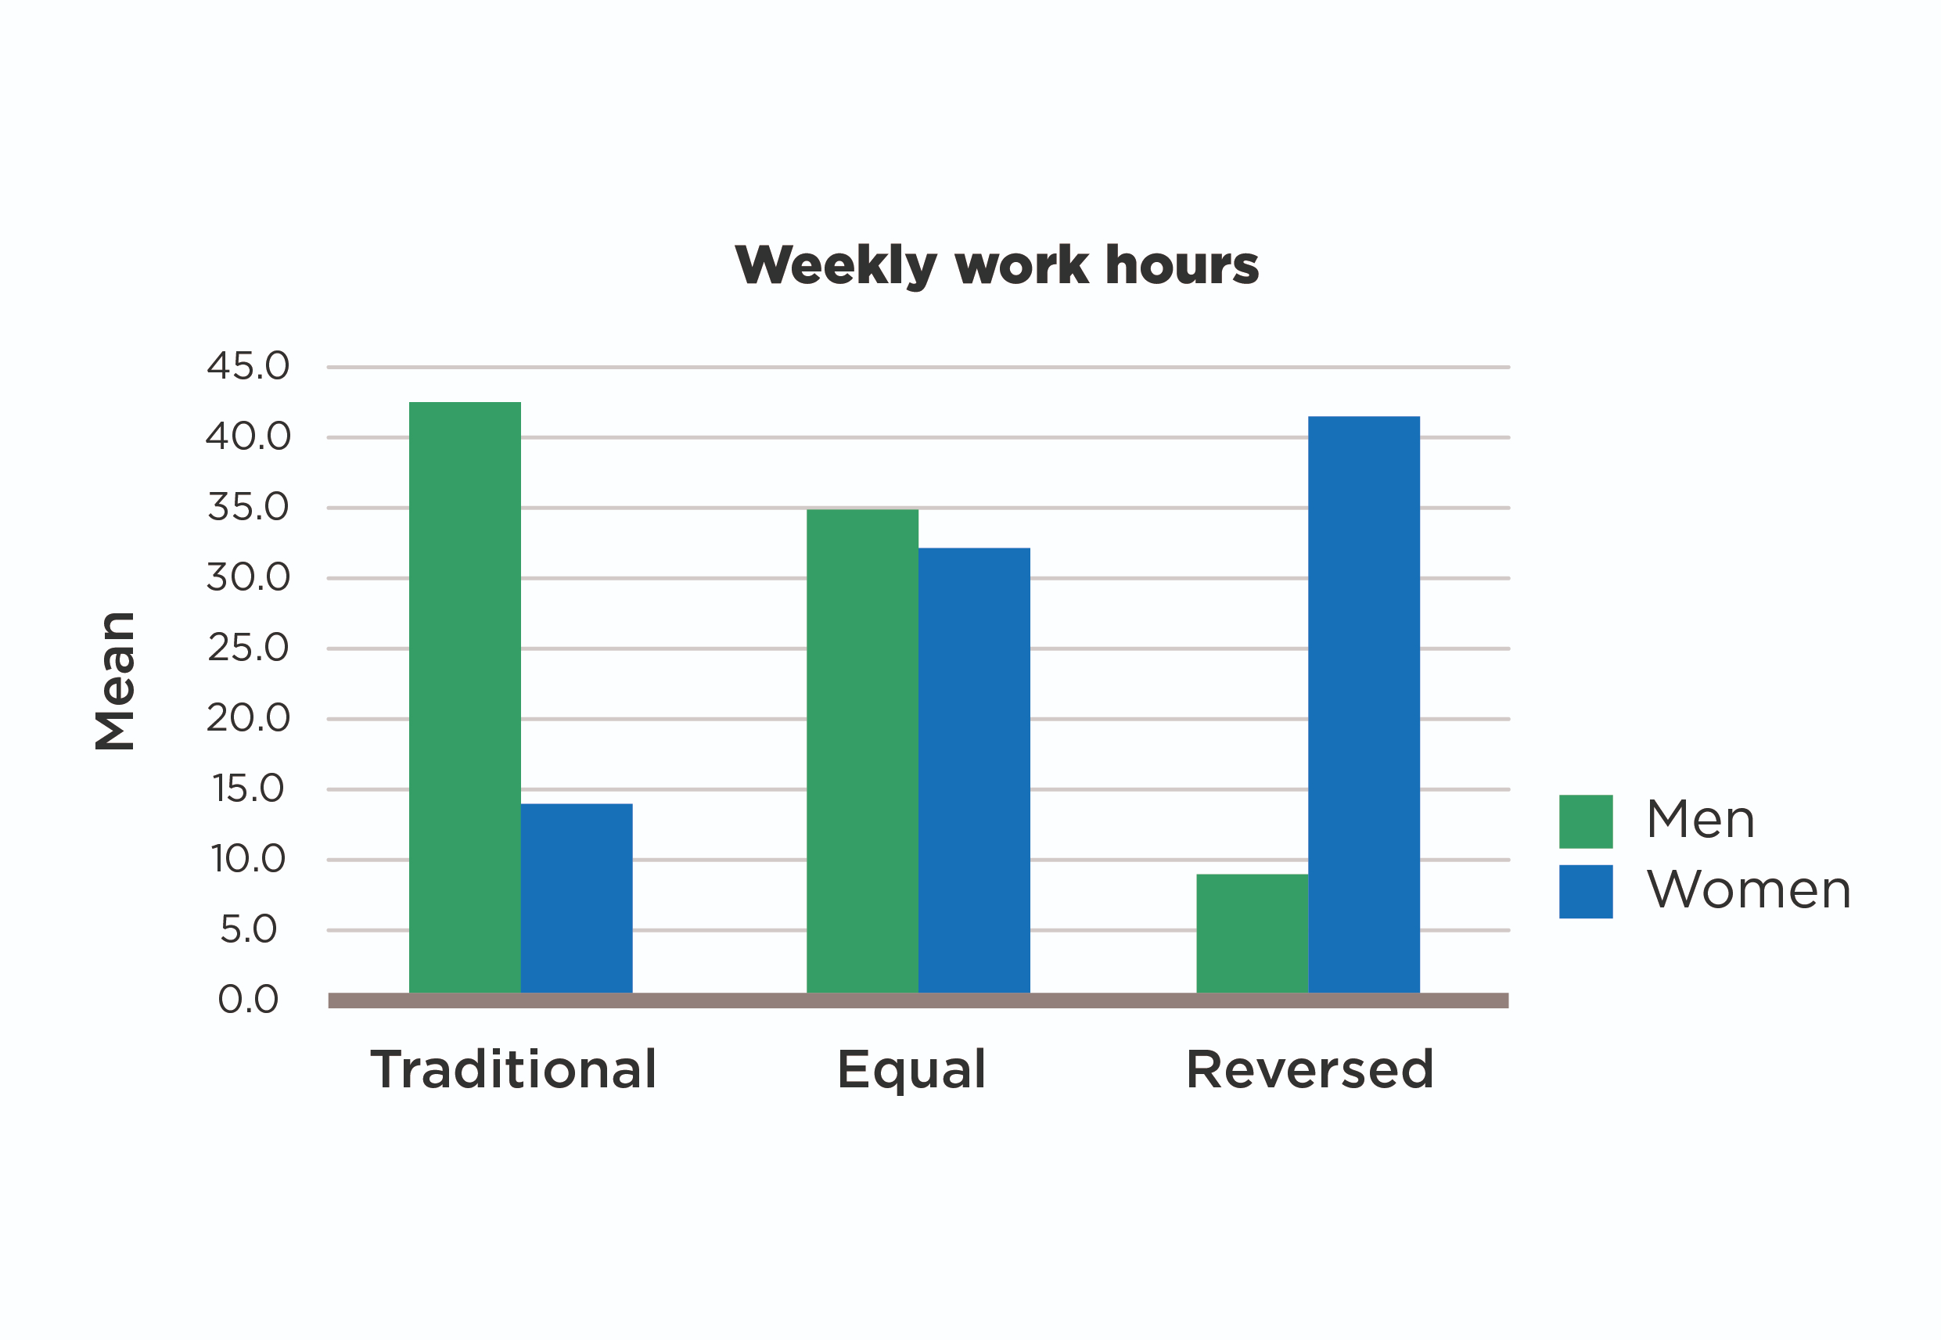
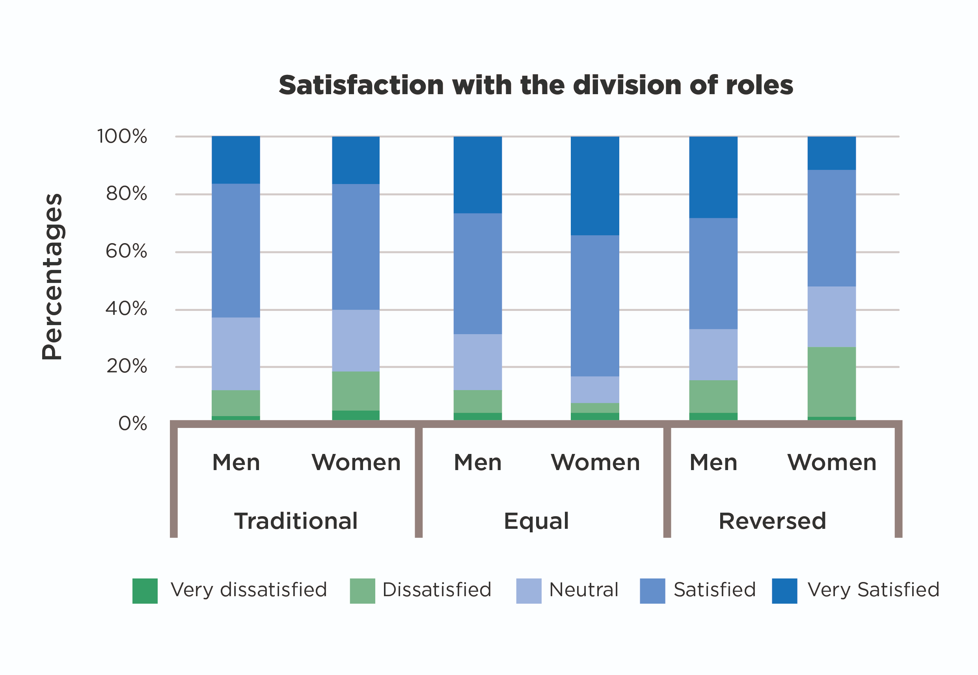
Key findings – equal sharing
Motivated by egalitarian gender ideologies, expectation of 50/50 split of family responsibilities, fathers’ desire for time with children and importance attributed to mothers’ paid work.
Conscious efforts to “fight for” equality.
Fathers and mothers worked shorter hours and spent more time with children as sole caregivers.
Mothers had highest levels of satisfaction with division of roles and equal sharers most likely to perceive their arrangement as resulting from their conscious choice.

Slide 9
Recommendation 1: Equal parental leave entitlement, including non-transferable ‘use-it-or-lose-it’ Parental Leave for fathers
Gendered policies around leave for parenting do not align with couples’ commitment to equality, fathers’ desire to be closely involved in their children’s lives, and mothers’ strong attachment to work.
Fathers who otherwise shared childcare equally or were the main caregivers were entitled to two weeks of Paternity Leave only, while their partners were paid to stay at home for the first 39 weeks of the child’s life. Shared Parental Leave was rarely utilised, either because couples were not entitled, could not afford the reduction in the father’s income, or mothers did not want to lose their time with their child by reducing their Maternity Leave.
These gendered leave policies therefore restrict couples’ choices and steer them into a traditional division of family roles despite their beliefs, preferences and parenting arrangements.

Slide 10
Recommendation 2: Government policies supporting shorter and more flexible work hours for both fathers and mothers
Flexibility in working hours, working from home, part-time working and emphasis on product/output-based (rather than time-based) work were all identified by parents as beneficial to managing childcare.
Both women and men reported barriers to securing such work arrangements, especially for more desirable or senior roles, with some suggesting that this was particularly a problem for men.
Parents whose partner’s work commitments were less flexible than their own felt forced to arrange their work around their partner’s job to facilitate childcare.
Parents would like to see the normalisation of part-time and flexible working for both fathers and mothers, and regardless of seniority.

Slide 11
Recommendation 3: Clearer, more visible workplace policies and underpinning family-friendly cultures
Parents’ experiences of workplaces are often dependent on individualised factors such as supportive or unsupportive managers, and employees are sometimes made responsible for being aware of policies and asserting their entitlement.
Employers can help to provide more consistently positive experiences for workers who are carers by improving clarity, knowledge and visibility around existing state and workplace specific policies and by encouraging family-friendly workplace cultures.

Slide 12
Recommendation 4: High quality affordable childcare provision to enable both parents to return to work after Parenting leave
The pressure on parents to identify a main caregiver and a main breadwinner is exacerbated by the lack of childcare alternatives.
This is particularly difficult in early years as unaffordable formal childcare often means that one parent must stay at home until the child turns 3 years old and qualifies for (limited) free provision.
Parents also find it difficult to juggle work commitments with childcare after school/nursery and during school holidays.
To enable both parents to maintain their involvement in paid work, affordable, formal and high-quality childcare provision should be made available from the age of 6 months.

Slide 13
Key take away
The findings point to a discrepancy between current state and workplace policies and parents’ actual views and preferences.
Gender norms and parents’ priorities are slowly changing, whereas outdated gendered policies continue to reinforce traditional norms and encourage mothers to stay at home or work part-time and fathers to work full time.
These policies are incompatible with fathers’ desire to spend more time with their children and work shorter/more flexible hours.
They are also incompatible with mothers’ strong work identities and desire to share family work with their partners.
Couples who overcome barriers posed by gendered policies and achieve greater equality contribute to a gradual pressure that can lead to the policy changes indicated by the findings.

Slide 14
Key take away
'It’s the not seeing those examples around us. […] there’s like inertia there, I think, and that’ll just take time, I suppose, it’ll take time for more men to be in that situation, more men to see other men in that situation. […] It’s just about creating the options, seeing the examples, having the experience, and then it’ll feel more natural and people will see it as less alien, I think'. (Mark, Traditional father, our emphasis)

Slide 15
Thanks for listening
Website: https://organisingworkandchildcare.blogs.lincoln.ac.uk/
Twitter: @work_childcare #sharingparenting
Report: https://www.nuffieldfoundation.org/wp-content/uploads/2019/11/Caregiving-Dads-Breadwinning-Mums-Full-Report-September-2022.pdf
Please complete our short survey
Media queries contact: anajordan@lincoln.ac.uk

